Slide 1
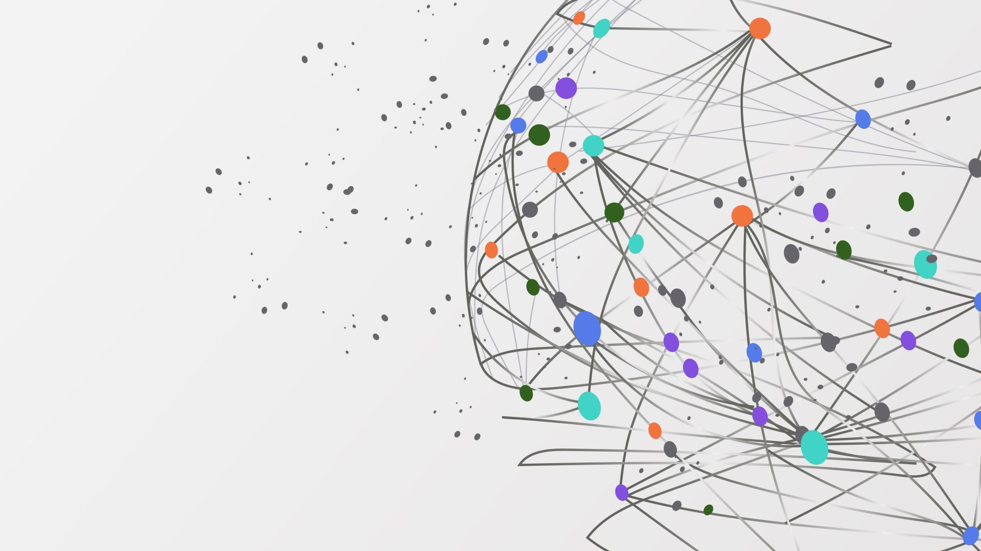
Development of an Autism Spectrum Disorder (ASD) Predictive Model and Diagnostic Web Application
Team Members:
1.Radiah Zaman Sarin
2. Careen Chowrappa

Slide 2

Introduction
ASD Overview: Neurodevelopmental condition affecting social interaction, communication, and behavior.
Significance: Prevalence (1 in 54 children in the US) and impact on individuals and families.
Importance of Prediction: Early identification facilitates timely intervention and support.
Project Objective: The purpose of our project is to develop a predictive model and diagnostic web application for ASD assessment to facilitate early detection and intervention.

Slide 3
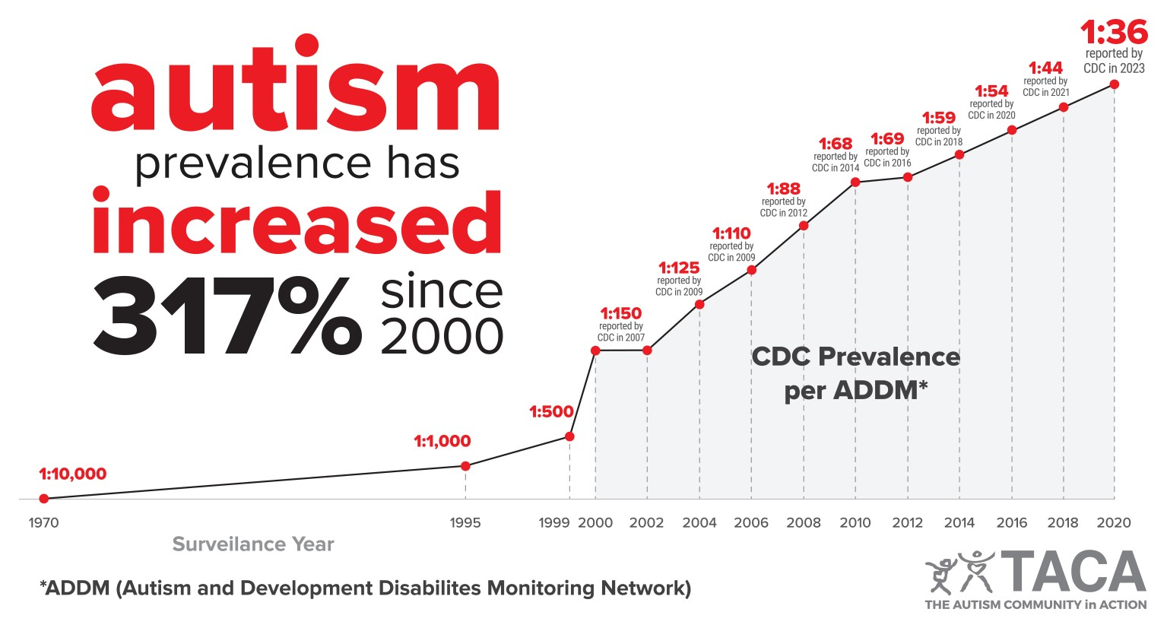
Autism Prevalence
CDC reports a 22% increase in autism prevalence rates since 2021.
Current prevalence stands at 1 in 36 individuals.

Slide 4

Project Overview
Develop a robust predictive model and a user-friendly web application for ASD assessment.
Acquired a comprehensive dataset from Kaggle and Conducted data cleaning, including standardizing the format and handling missing values.
Preprocessed the data by encoding categorical variables and scaling numerical features.
Transformed target labels, assigning "Yes" values to 1 and "No" values to 0 for consistency.
Implemented machine learning algorithms including SVM, Decision Tree, Random Forest and Logistic Regression for model training.
Evaluated model performance using metrics like accuracy, sensitivity,specificity, and AUC-ROC.
Conducted a comparison with baseline models or existing diagnostic tools to assess improvement in prediction accuracy.
Adhered to ethical guidelines regarding data privacy, fairness, transparency, and accountability.
Utilized visualization techniques such as bar charts and correlation matrices to gain insights into the data and enhance model interpretability.
Developed a user-friendly web application integrating the trained models for real-time ASD likelihood prediction.

Slide 5

WORKFLOW
Machine Learning Models:
Support Vector Machine (SVM)
Logistic Regression
Random Forest
Decision Tree Classifier
KNN Classifier
Data Preprocessing Steps:
Data cleaning to handle missing values and outliers.
Normalization to scale features to a uniform range.
Encoding categorical variables for numerical representation.
Feature Selection Techniques:
Feature importance analysis.
Recursive feature elimination.
Model Training Process:
Split data into training and testing sets.
Streamlit Webpage
Data Collection
Dataset: https://www.kaggle.com/datasets/uppulurimadhuri/dataset

Slide 6
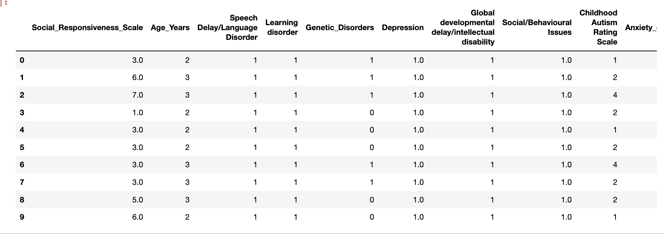
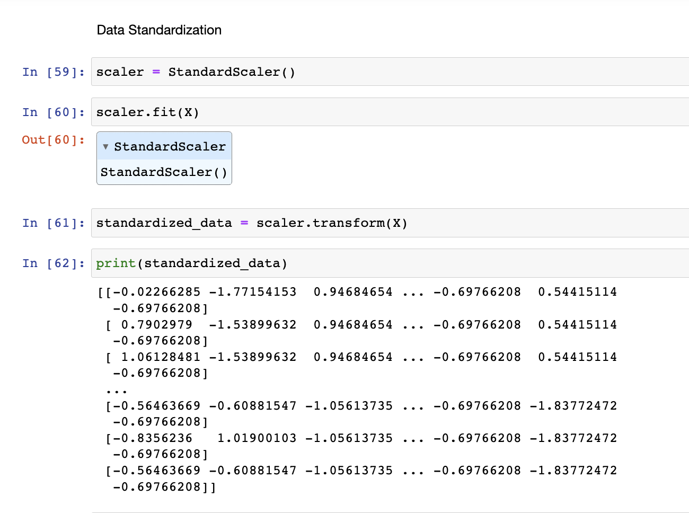
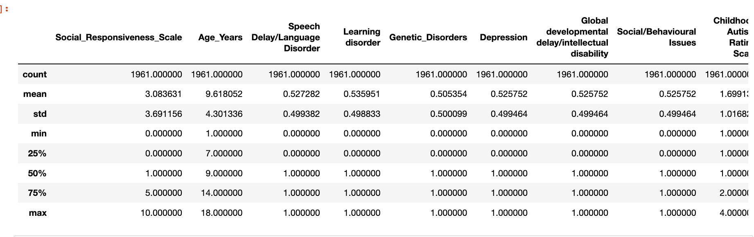
Dataset
Dataset
The dataset provides the foundation for our models, ensuring they're built on accurate and representative data.
Data standardization allows us to normalize variables, ensuring fair comparisons and optimal model performance.
Statistical measures provide insights into the central tendencies and distributions of our data, guiding our understanding and decision-making processes.
Data Standardization
Statistical Measures

Slide 7
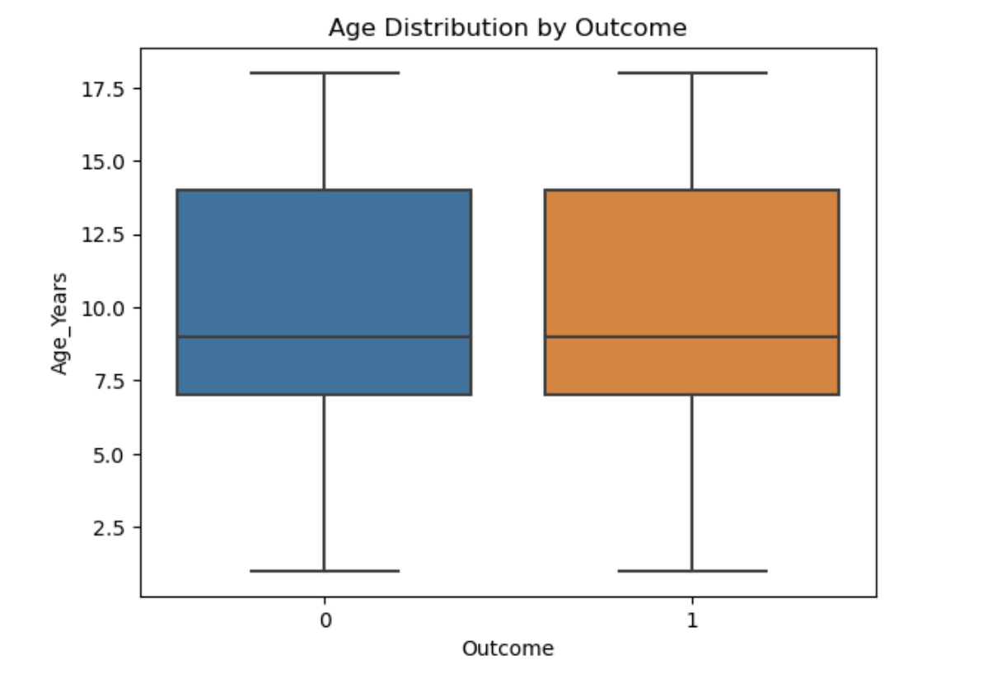
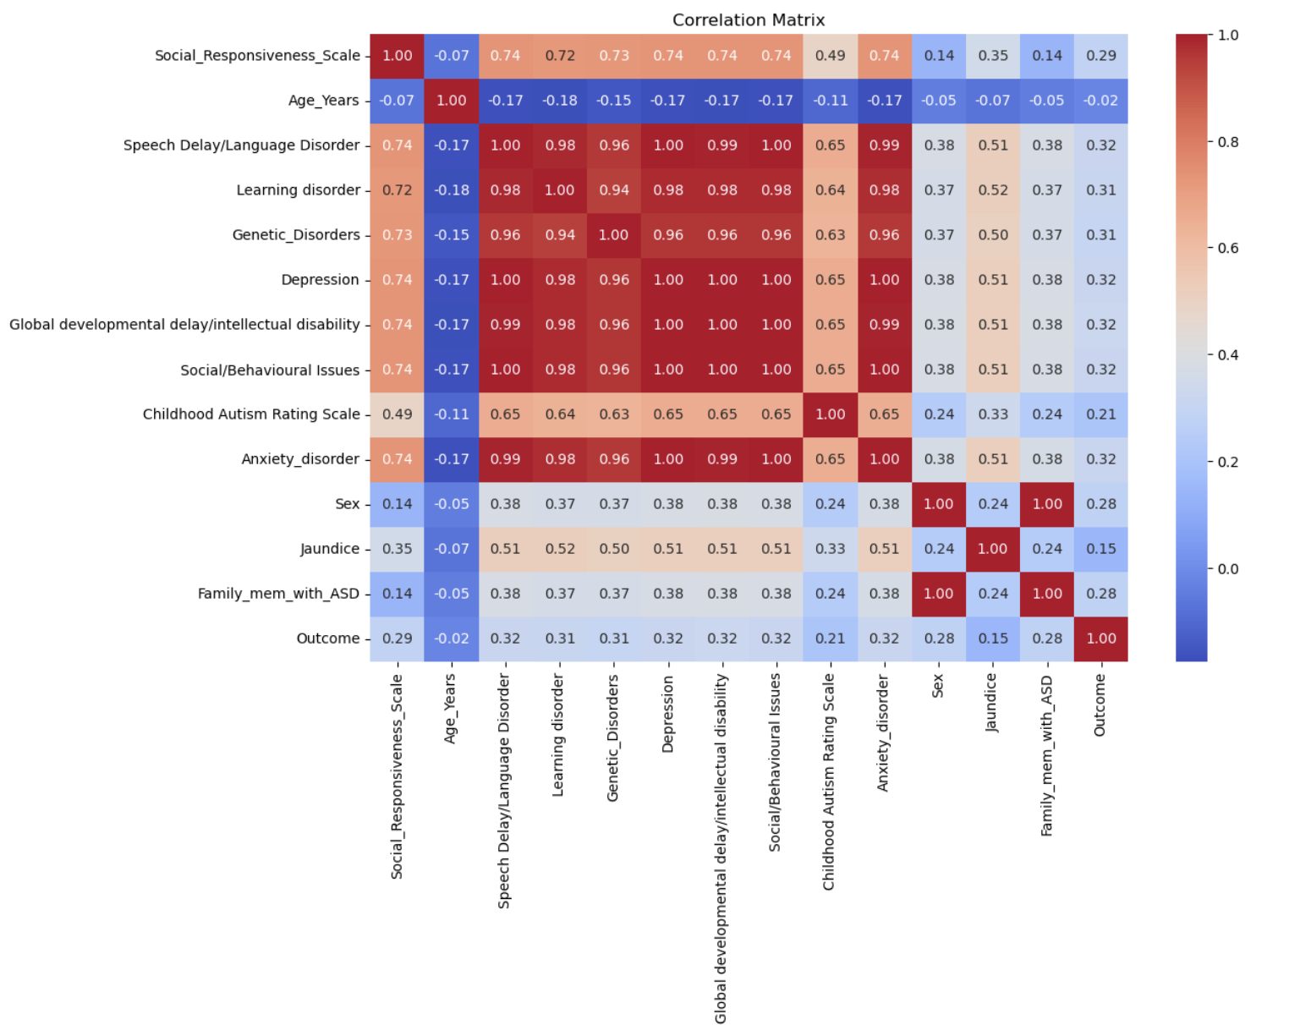
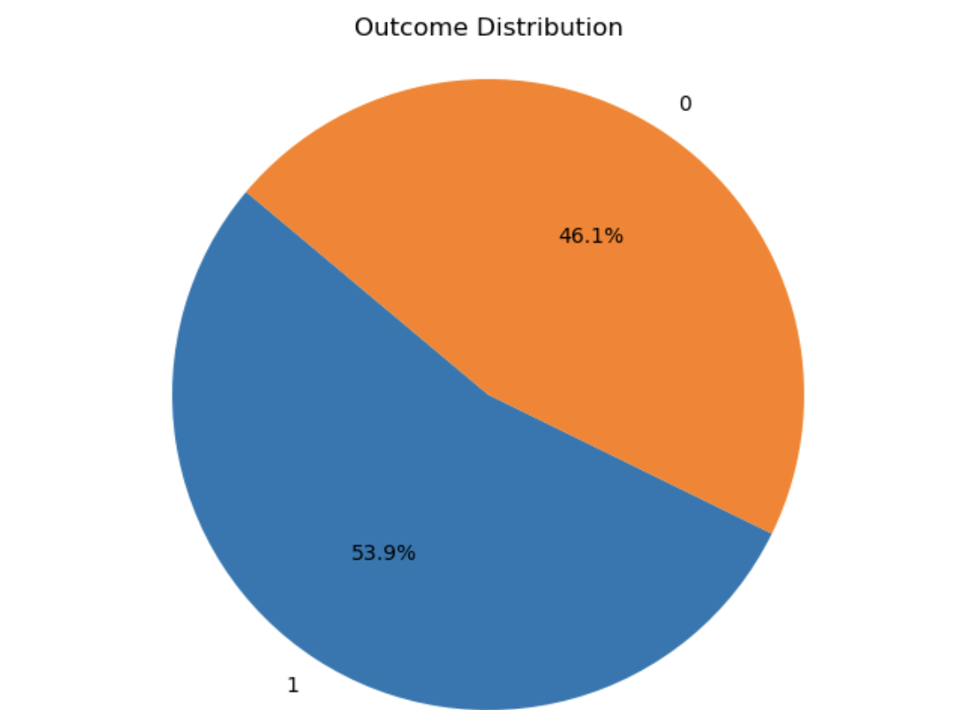
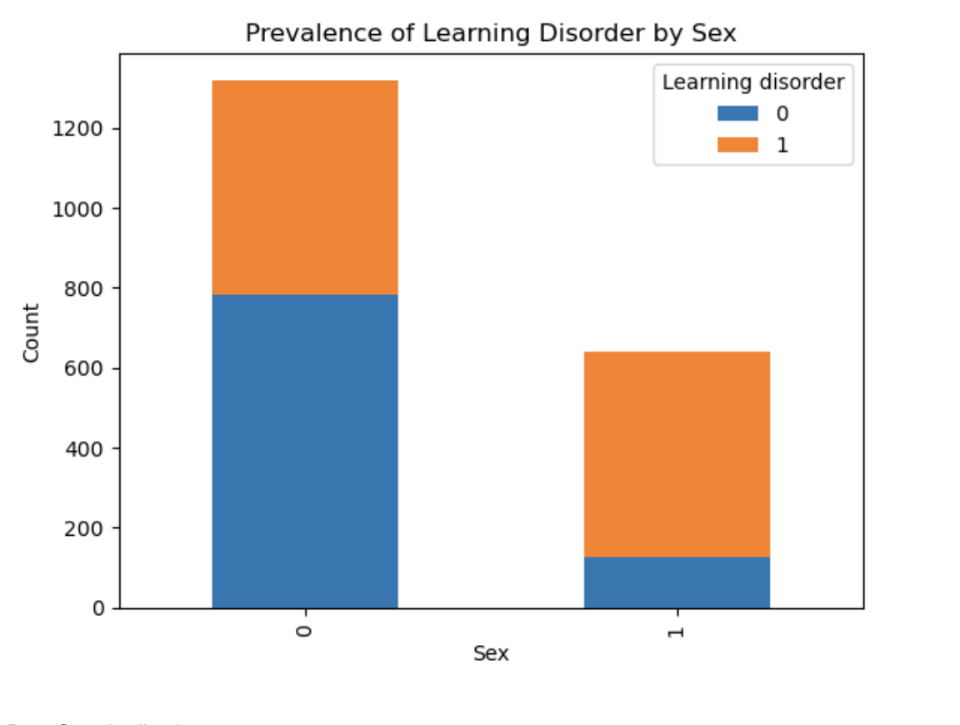
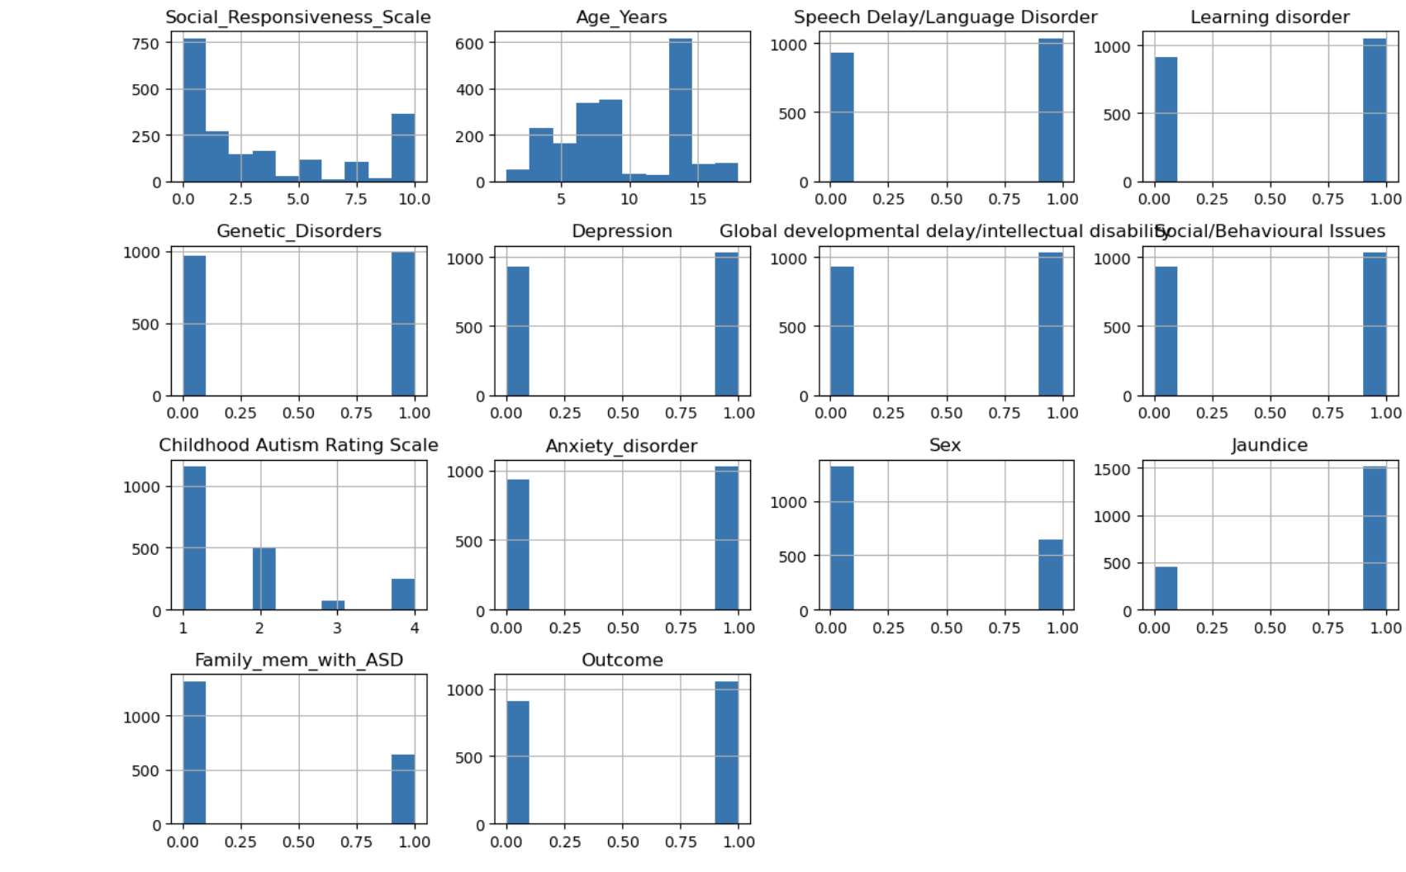
exploratory data analysis
Histograms: Visualized numerical feature distributions, providing insight into the spread and concentration of data points within each feature, aiding in identifying any potential patterns or outliers.
Correlation Matrix: Examined feature relationships by displaying the correlation coefficients between pairs of numerical features, helping to identify variables that may be strongly related or exhibit multicollinearity.
Age Distribution by Outcome: Explored age-related patterns within different outcome categories, allowing for the identification of any age-related trends or differences in outcomes across age groups.
Learning Disorder by Sex: Investigated language development by comparing the prevalence of learning disorders between different sexes, providing insights into potential gender differences in language-related challenges or diagnoses.
Outcome Distribution: Examined the distribution of outcomes across the dataset, providing an overview of the prevalence of different outcomes and highlighting any imbalances or patterns in the dataset.
.
Feature Distribution

Slide 8
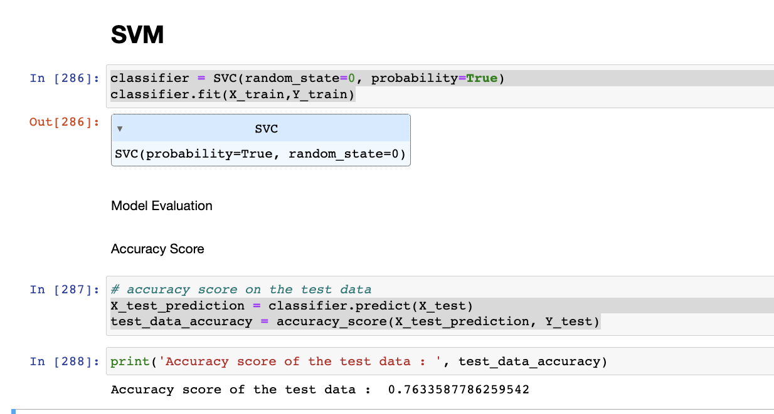
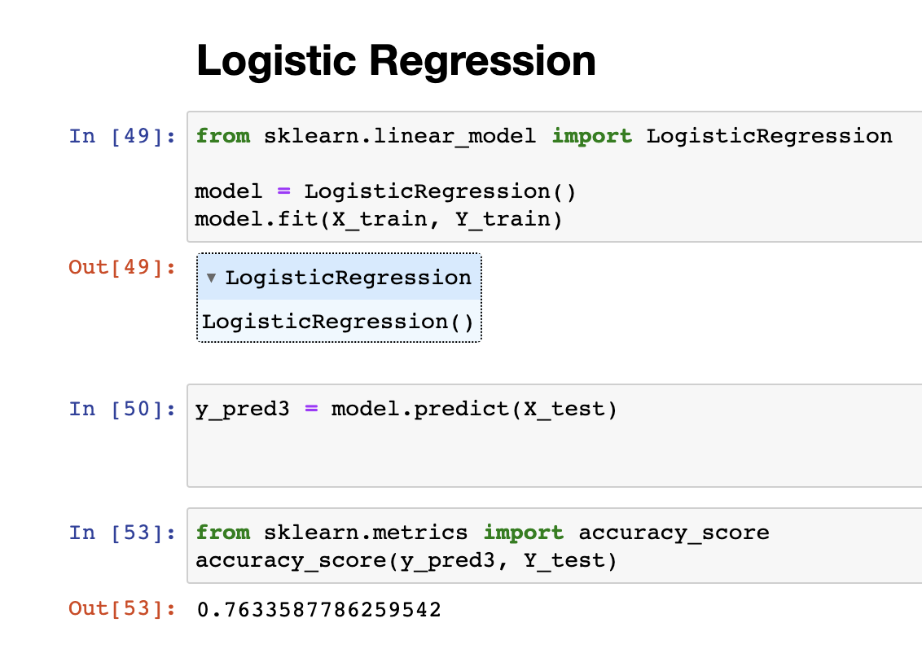
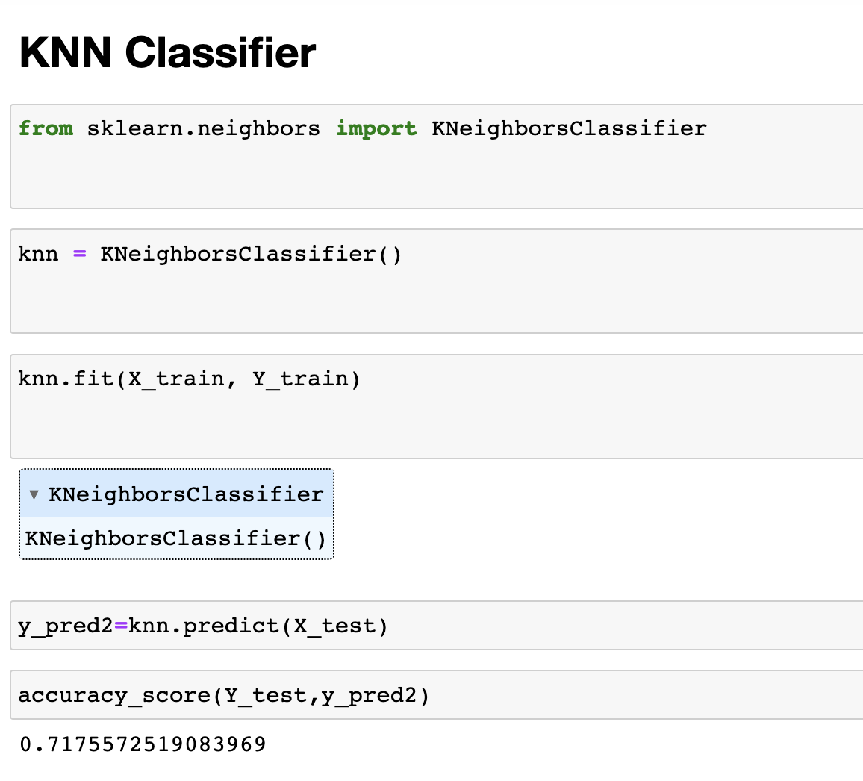
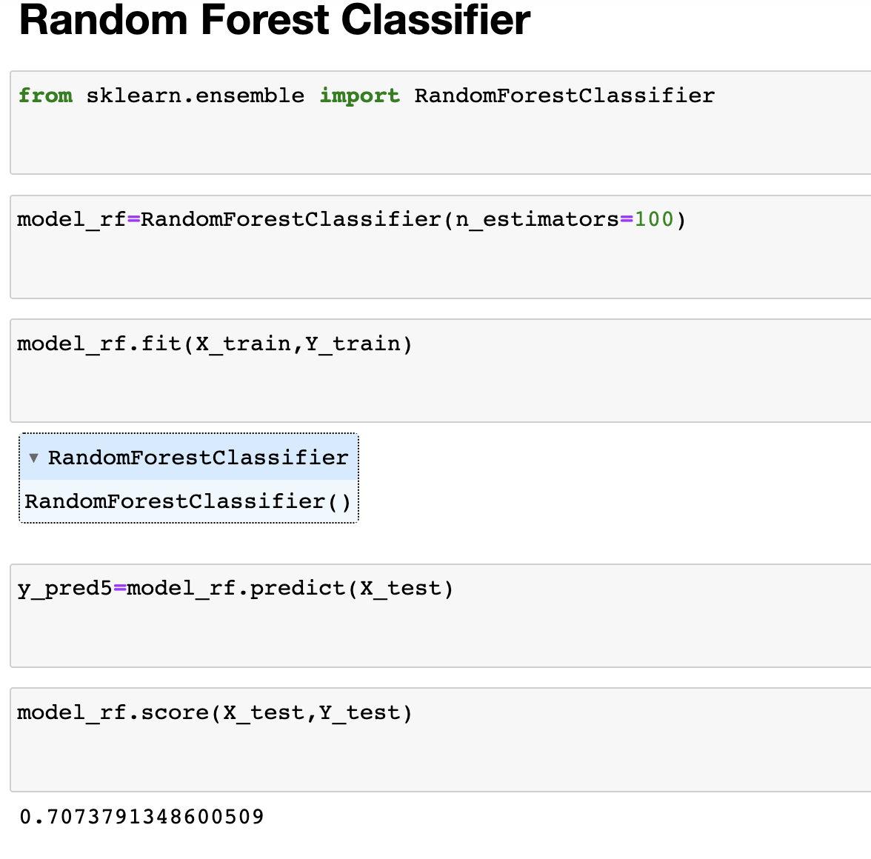
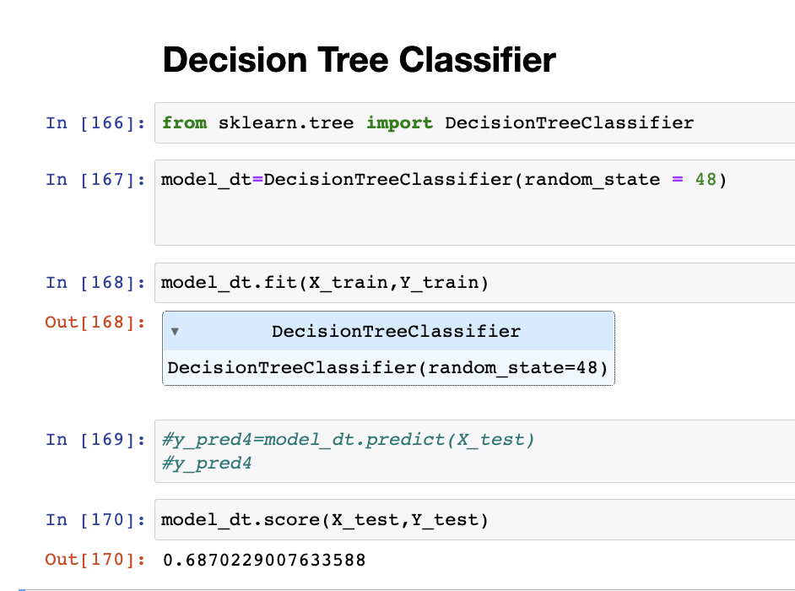
Model Evaluation
Accuracy of the models:
Support Vector Machine (SVM) : 76%
Logistic Regression : 76%
Random Forest: 70%
Decision Tree Classifier: 68%
K-Nearest Neighbors (KNN): 71%

Slide 9
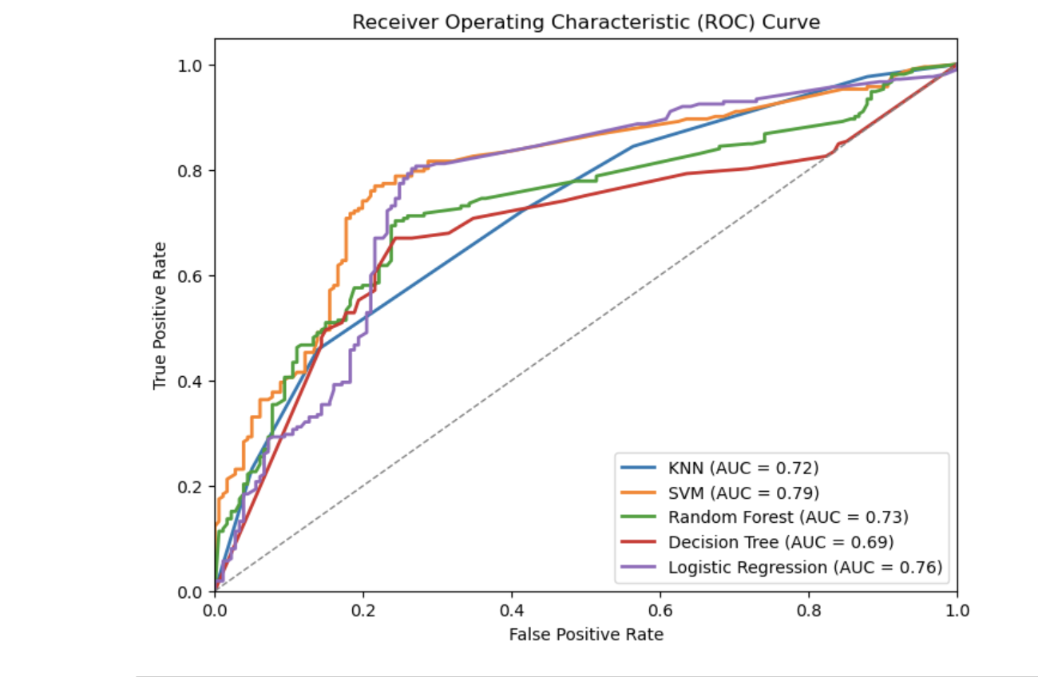
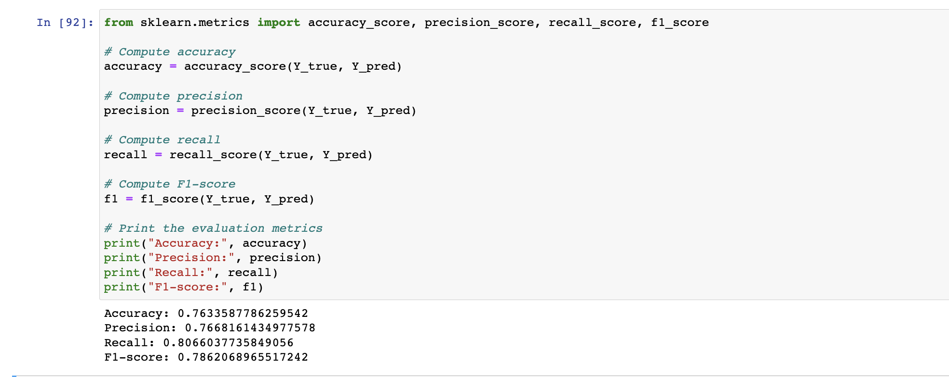
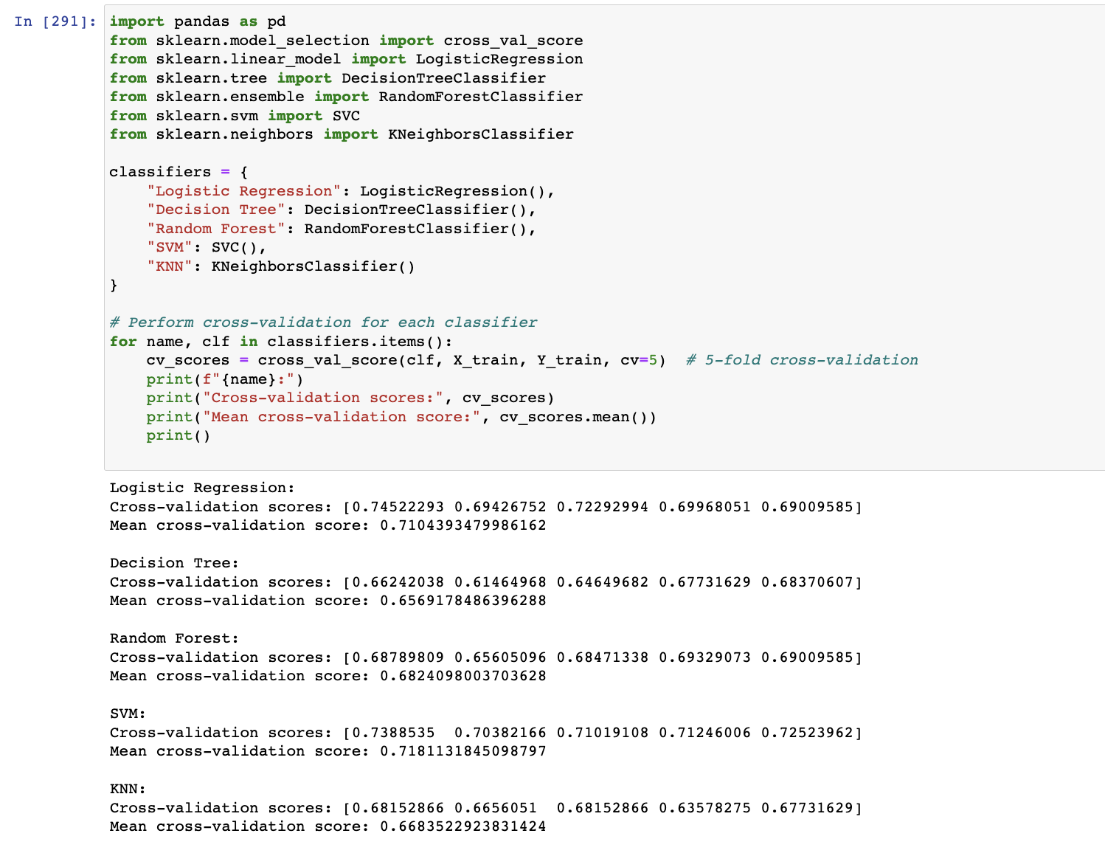
Model evaluation results
In our study, we used cross-validation to check how well each model works, looking at both the individual scores and the average score for a more reliable assessment. We also looked closely at important measures like accuracy, precision, recall, and F1-score specifically for the SVM model to understand how accurate it is. the ROC curve for each model is plotted, along with a diagonal reference line indicating random guessing. The resulting graph provides a visual representation of each model's ability to distinguish between true positives and false positives across different threshold values. A higher AUC value indicates better performance in classification tasks.
SVM

Slide 10

Streamlit Web app
Register: The registration and login page enables users to sign up with a username and password or log in securely. Upon successful registration or login, users are directed to the dashboard.
Home: The home page provides an introduction to Autism Spectrum Disorder (ASD), covering its definition, causes, and symptoms, along with relevant statistics.
Dashboard : The dashboard offers a comprehensive view of ASD traits over five years, with interactive plots showcasing statistics based on selected traits and gender demographics. Users can explore trends in jaundice, Childhood Autism Rating Scale scores, family history of ASD, and Social Responsiveness Scale scores.
Form : The Streamlit app offers autism risk assessment and appointment scheduling. Users input data for prediction and receive the likelihood of an autism diagnosis. They can then select a doctor and email them directly for consultation and appointments, promoting proactive healthcare management.
Contact : The contact page provides a platform to reach out to us effortlessly. Users can fill in their name, email, and message in the form below and click "Send" to submit their inquiry. We aim to respond promptly to all queries and feedback.

Slide 11
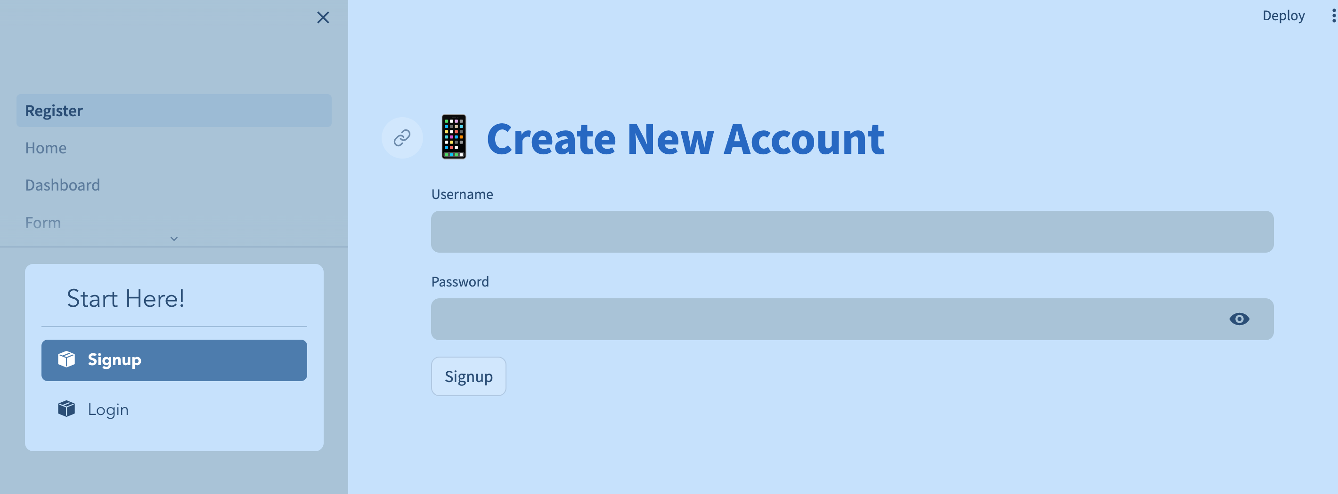
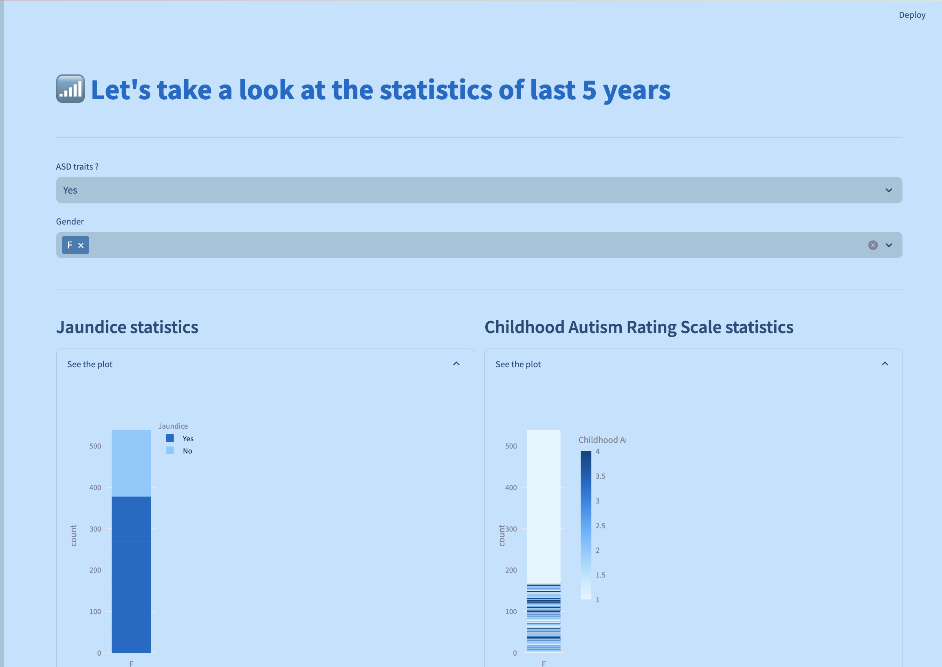
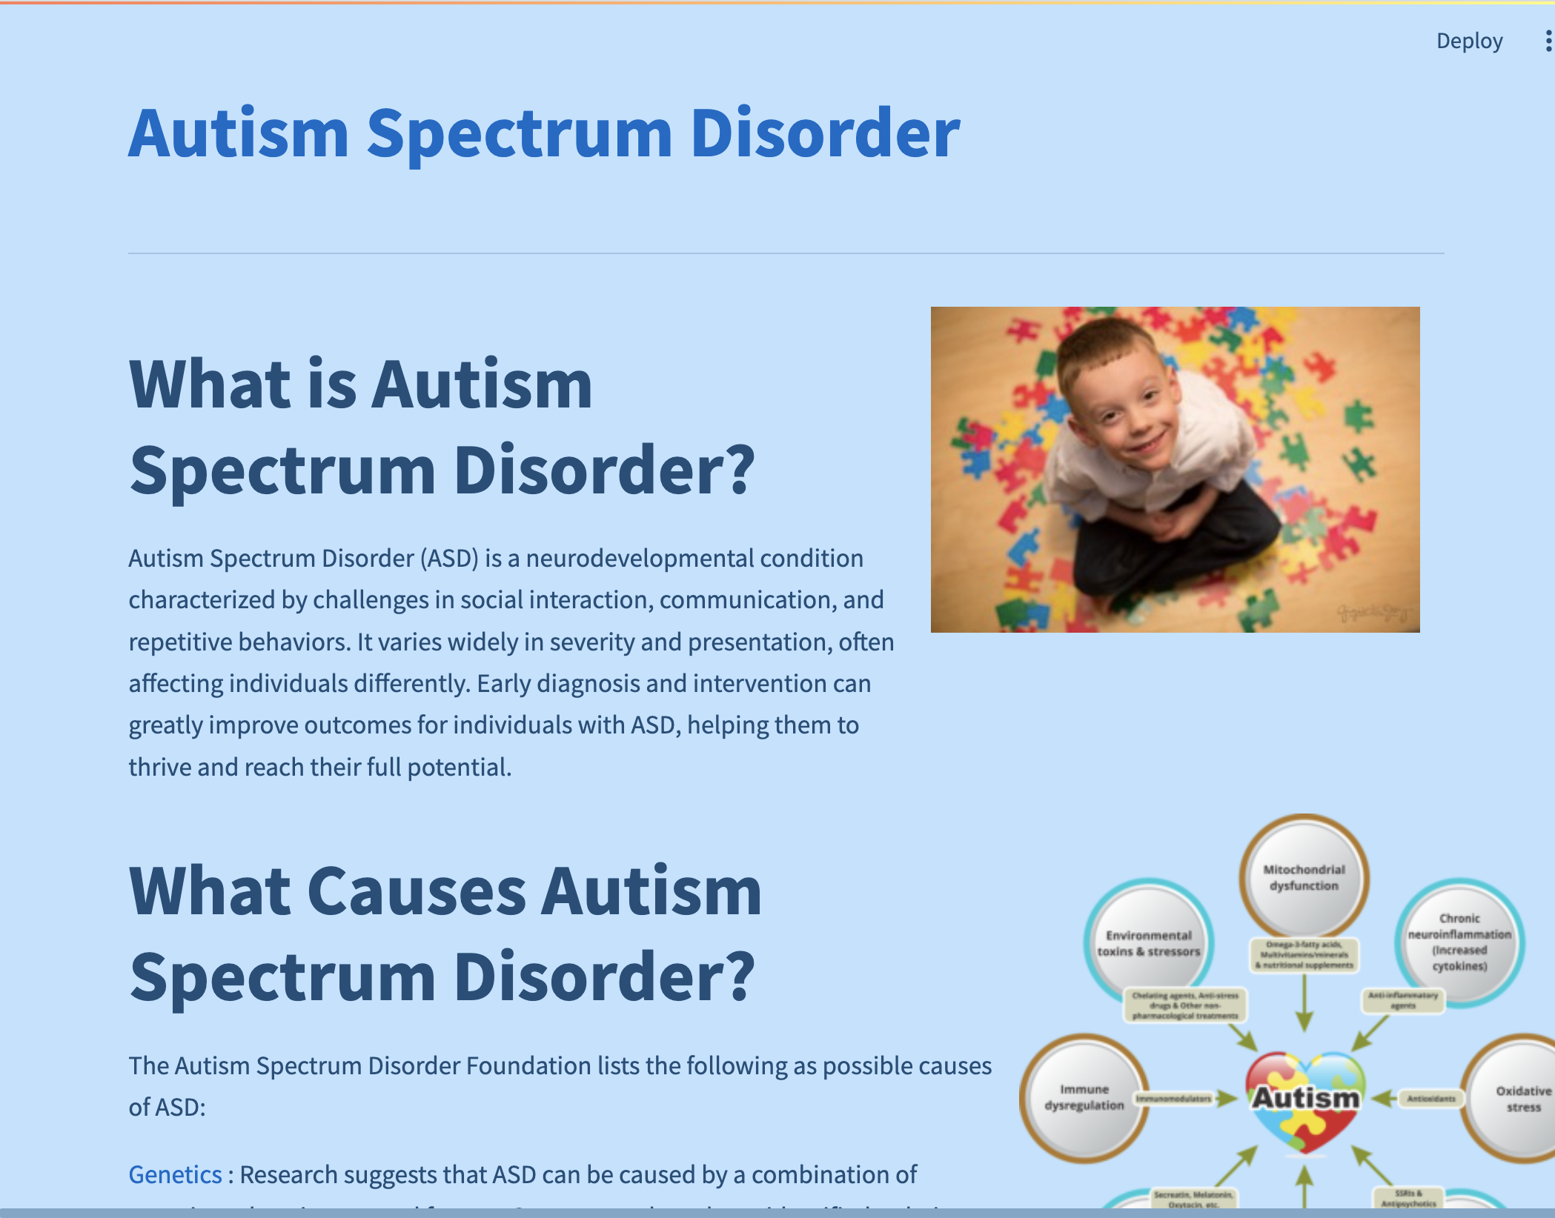
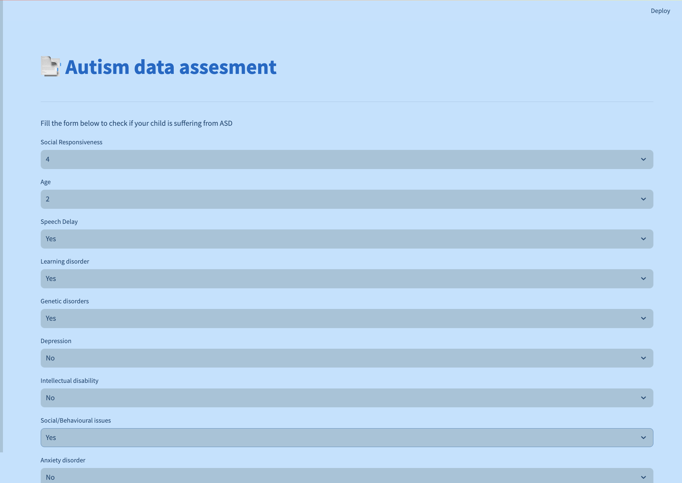
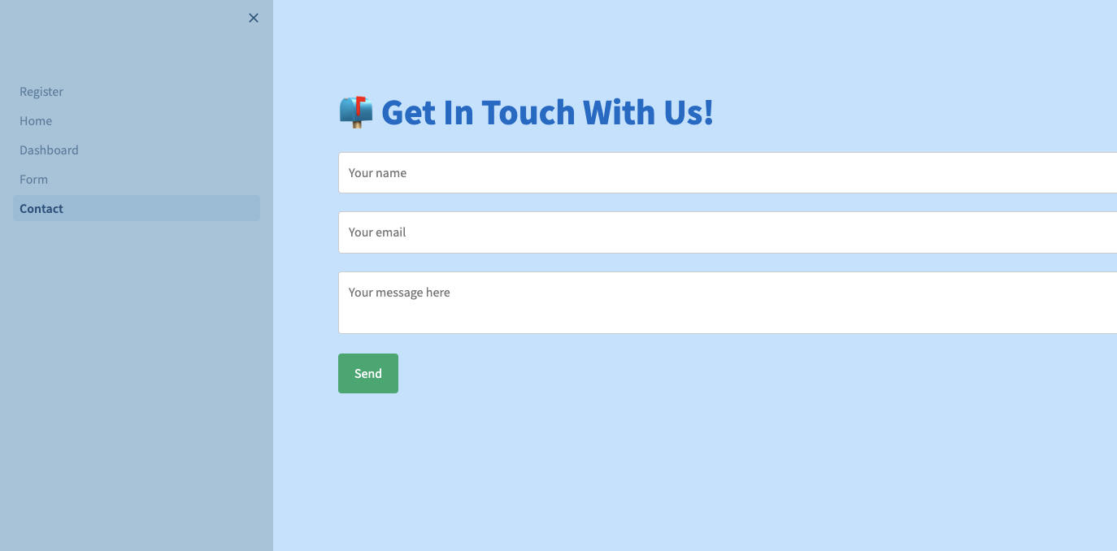
Streamlit Web app
Register
Dashboard
Home
Form
Contact

Slide 12
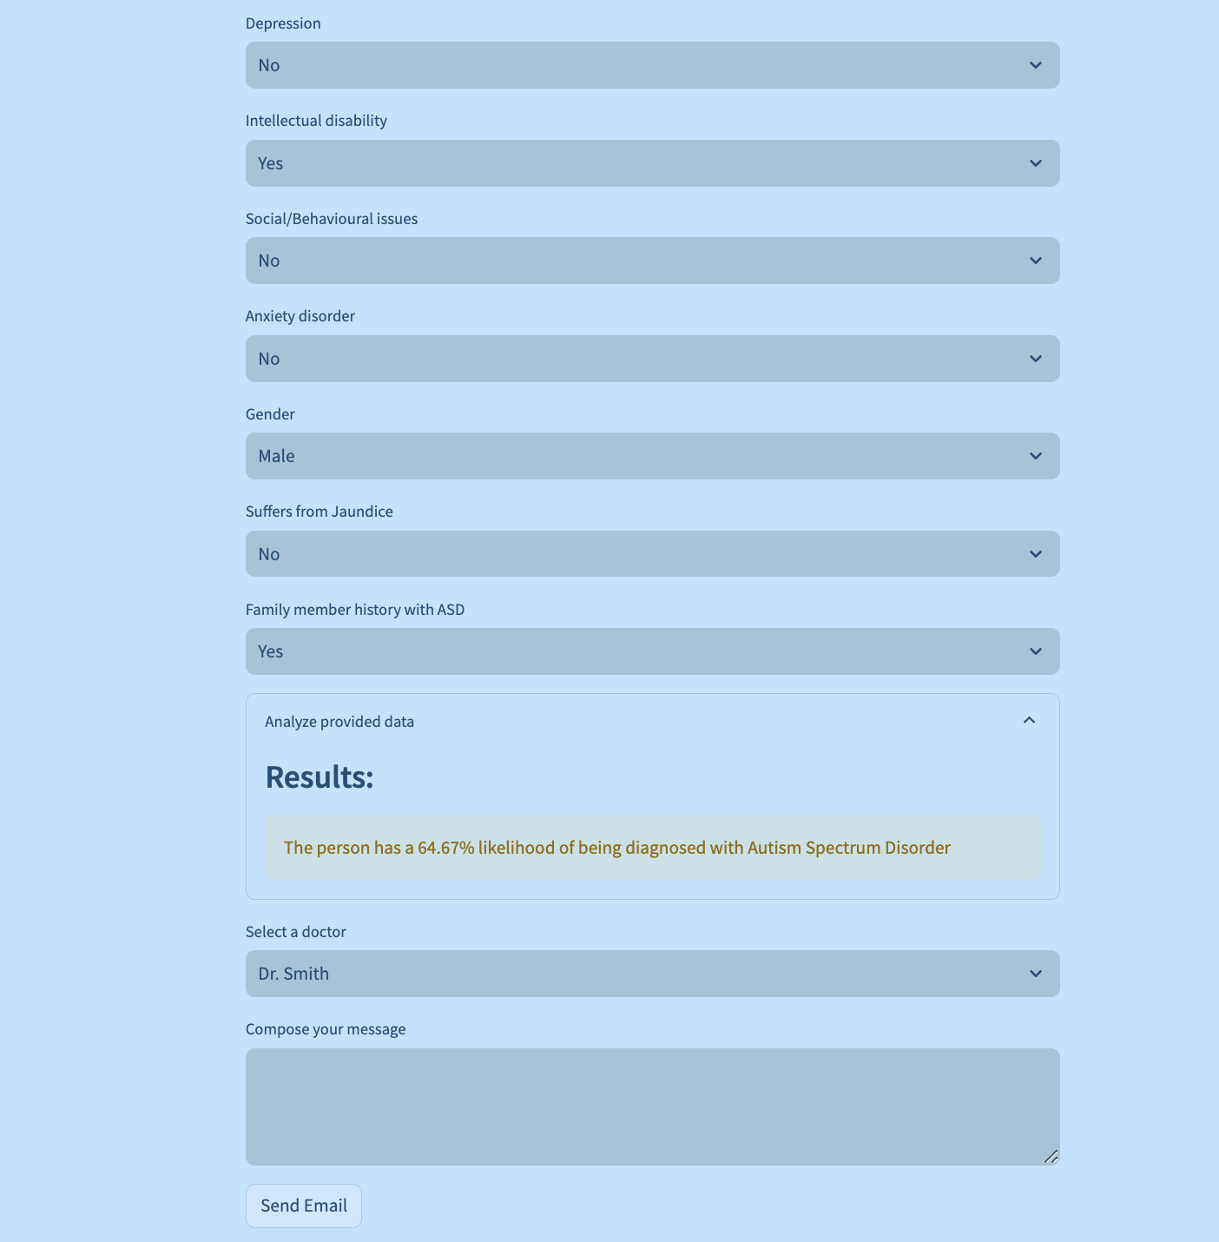
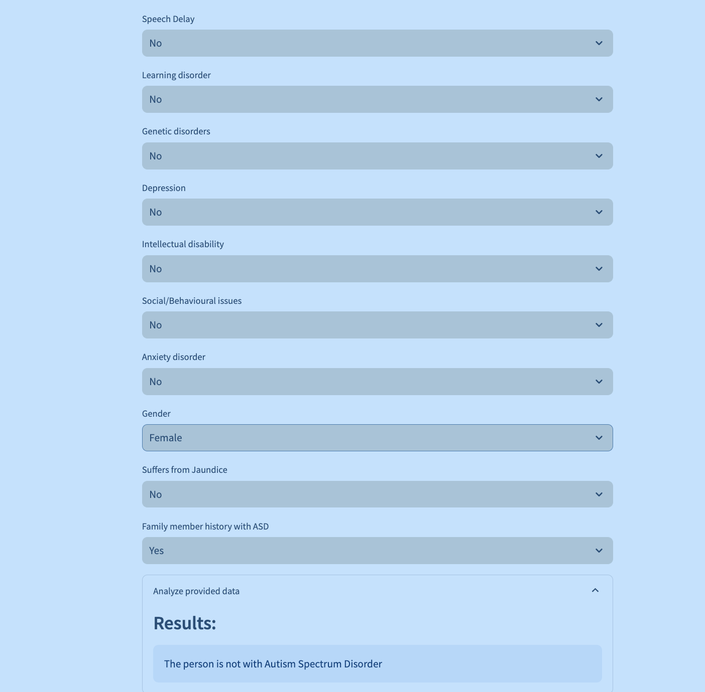
Results(Web app)
Our platform offers a seamless experience for individuals seeking autism diagnosis and professional consultation. Users provide personal details through a user-friendly form and receive immediate feedback on the likelihood of autism diagnosis, including the percentage probability. This insight empowers informed decisions and understanding. For those with a suspected autism diagnosis, our platform facilitates direct communication with trusted doctors for appointments or advice. This streamlined process ensures prompt diagnosis and access to professional guidance, enhancing the user experience and promoting proactive healthcare management.

Slide 13
THANK YOU

